Slide 1
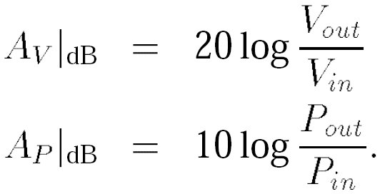
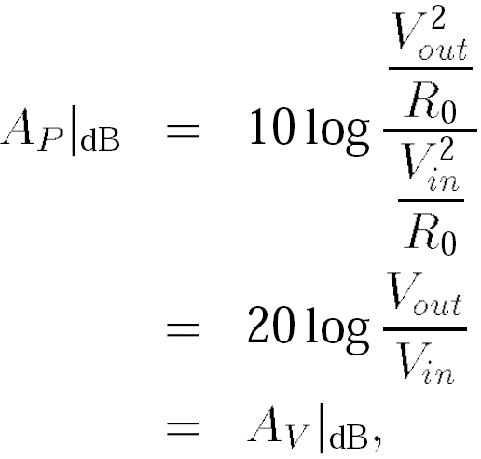
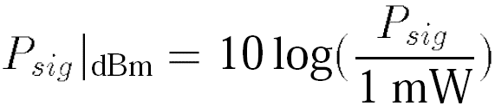
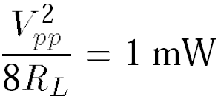

General Considerations: Units in RF Design
This relationship between Power and Voltage only holds when the input and output impedance are equal
An amplifier senses a sinusoidal signal and delivers a power of 0 dBm to a load resistance of 50 Ω. Determine the peak-to-peak voltage swing across the load.
Solution:
where R_{L}= 50 Ω thus,

Slide 2
Example of Units in RF
A GSM receiver senses a narrowband (modulated) signal having a level of -100 dBm. If the front-end amplifier provides a voltage gain of 15 dB, calculate the peak-to-peak voltage swing at the output of the amplifier.
Solution:
Since the amplifier output voltage swing is of interest, we first convert the received signal level to voltage. From the previous example, we note that -100 dBm is 100 dB below 632 mV_{pp}. Also, 100 dB for voltage quantities is equivalent to 105. Thus, -100 dBm is equivalent to 6.32 μV_{pp}. This input level is amplified by 15 dB (≈ 5.62), resulting in an output swing of 35.5 μV_{pp}.
Output voltage of the amplifier is of interest in this example

Slide 3
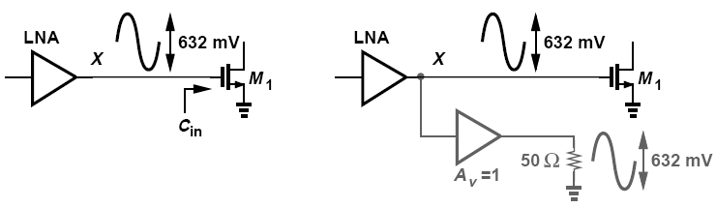
dBm Used at Interfaces Without Power Transfer
dBm can be used at interfaces that do not necessarily entail power transfer
We mentally attach an ideal voltage buffer to node X and drive a 50-Ω load. We then say that the signal at node X has a level of 0 dBm, tacitly meaning that if this signal were applied to a 50-Ω load, then it would deliver 1 mW.

Slide 4
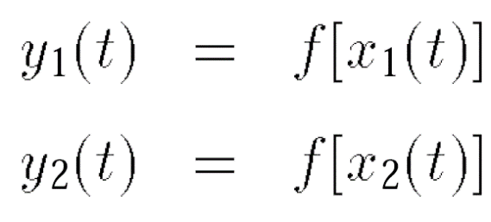
General Considerations: Time Variance
A system is linear if its output can be expressed as a linear combination (superposition) of responses to individual inputs.
A system is time-invariant if a time shift in its input results in the same time shift in its output.
If y(t) = f [x(t)]
then y(t-τ) = f [x(t-τ)]

Slide 5

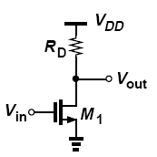
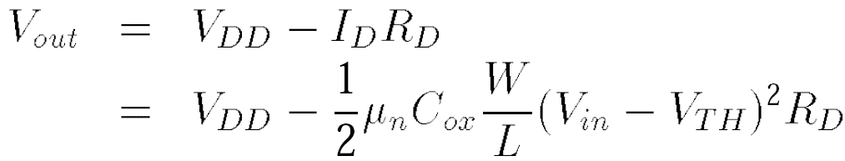
Nonlinearity: Memoryless and Static System
linear
nonlinear
The input/output characteristic of a memoryless nonlinear system can be approximated with a polynomial
In this idealized case, the circuit displays only second-order nonlinearity

Slide 6


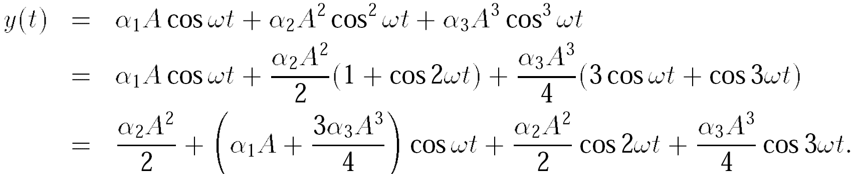
Effects of Nonlinearity: Harmonic Distortion
Linear Time-invariant Linear Time-variant
The output of a “dynamic” system depends on the past values of its input/output
DC
Fundamental
Second
Harmonic
Third
Harmonic
Even-order harmonics result from α_{j} with even j
nth harmonic grows in proportion to An

Slide 7
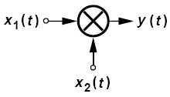
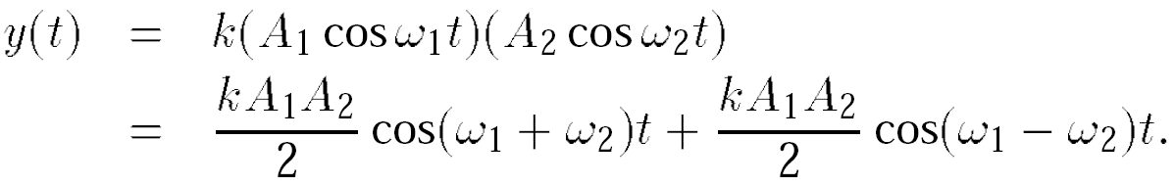
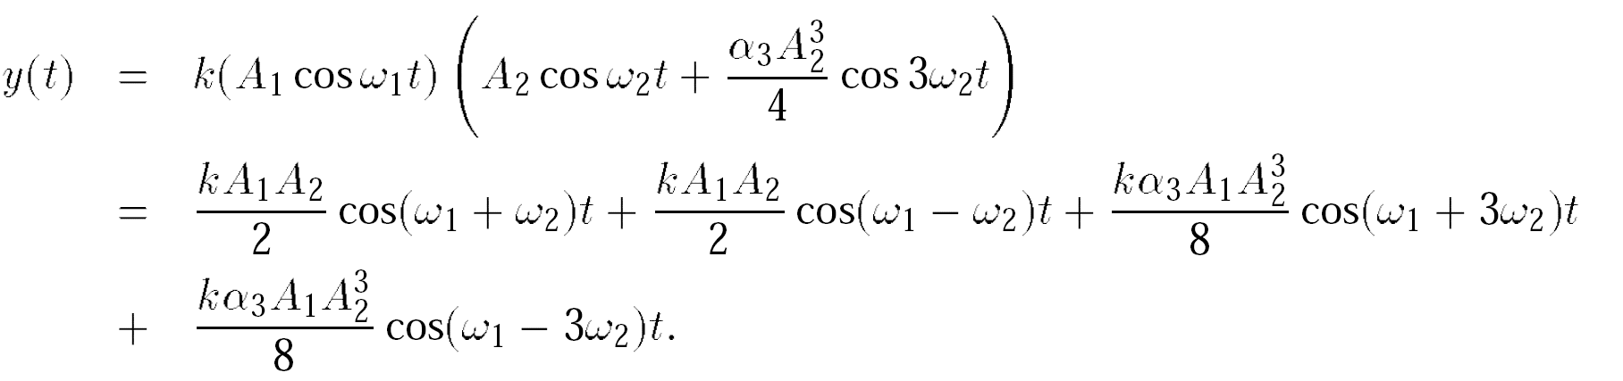
Example of Harmonic Distortion in Mixer
An analog multiplier “mixes” its two inputs below, ideally producing y(t) = kx₁(t)x₂(t), where k is a constant. Assume x₁(t) = A₁ cos ω₁t and x₂(t) = A₂ cos ω₂t.
If the mixer is ideal, determine the output frequency components.
(b) If the input port sensing x₂(t) suffers from third-order nonlinearity, determine the output frequency components.
Solution:
(a)
(b)

Slide 8
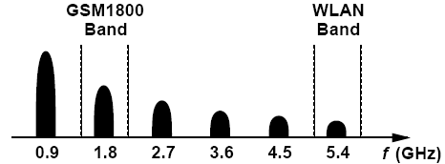
Example of Harmonics on GSM Signal
The transmitter in a 900-MHz GSM cellphone delivers 1 W of power to the antenna. Explain the effect of the harmonics of this signal.
Solution:
The second harmonic falls within another GSM cellphone band around 1800 MHz and must be sufficiently small to negligibly impact the other users in that band. The third, fourth, and fifth harmonics do not coincide with any popular bands but must still remain below a certain level imposed by regulatory organizations in each country. The sixth harmonic falls in the 5-GHz band used in wireless local area networks (WLANs), e.g., in laptops. Figure below summarizes these results.

Slide 9
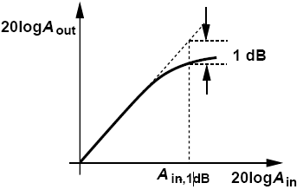
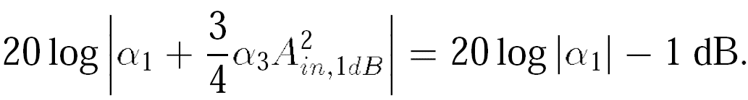
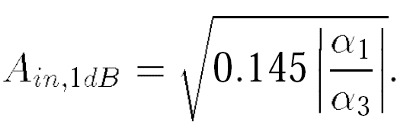
Gain Compression: 1-dB Compression Point
Output falls below its ideal value by 1 dB at the 1-dB compression point
Peak value instead of peak-to-peak value

Slide 10
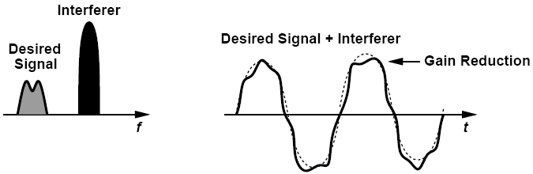
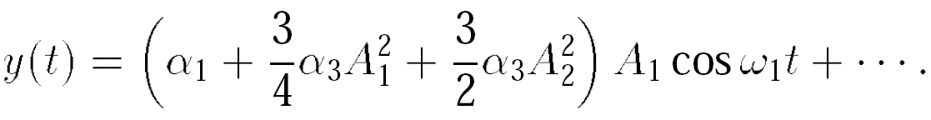
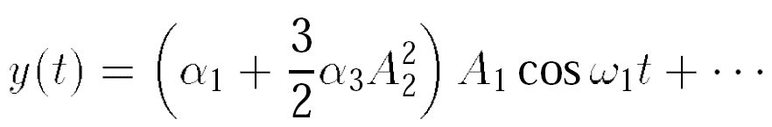
Gain Compression: Desensitization
For A₁ << A₂
Desensitization: the receiver gain is reduced by the large excursions produced by the interferer even though the desired signal itself is small.

Slide 11
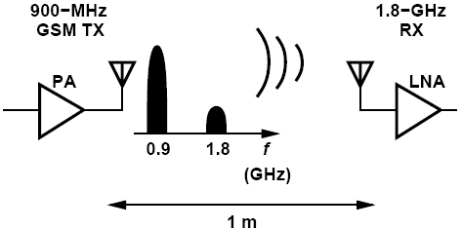
Example of Gain Compression
A 900-MHz GSM transmitter delivers a power of 1 W to the antenna. By how much must the second harmonic of the signal be suppressed (filtered) so that it does not desensitize a 1.8-GHz receiver having P_{1dB} = -25 dBm? Assume the receiver is 1 m away and the 1.8-GHz signal is attenuated by 10 dB as it propagates across this distance.
Solution:
The output power at 900 MHz is equal to +30 dBm. With an attenuation of 10 dB, the second harmonic must not exceed -15 dBm at the transmitter antenna so that it is below P_{1dB} of the receiver. Thus, the second harmonic must remain at least 45 dB below the fundamental at the TX output. In practice, this interference must be another several dB lower to ensure the RX does not compress.

Slide 12
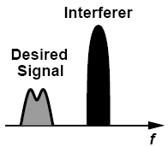
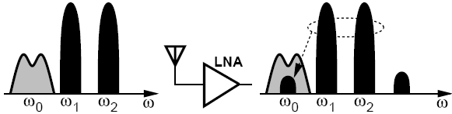
Effects of Nonlinearity: Intermodulation— Recall Previous Discussion
So far we have considered the case of:
Single Signal
Signal + one large interferer
Signal + two large interferers
Harmonic distortion
Desensitization
Intermodulation

Slide 13
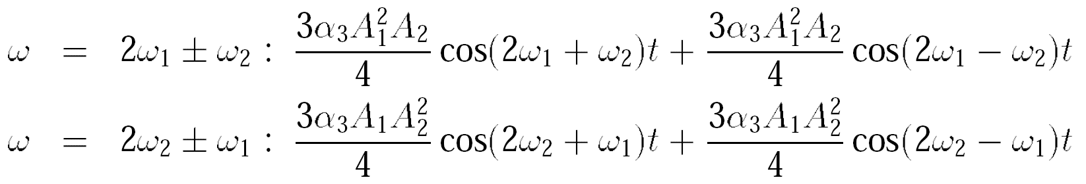
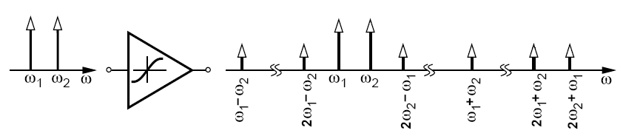
Effects of Nonlinearity: Intermodulation
assume
Thus
Intermodulation products:
Fundamental components:

Slide 14
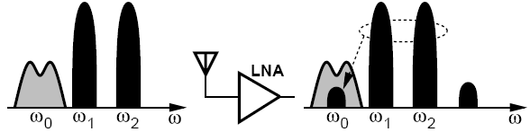

Intermodulation Product Falling on Desired Channel
Interferer
desired
A received small desired signal along with two large interferers
Intermodulation product falls onto the desired channel, corrupts signal.

Slide 15
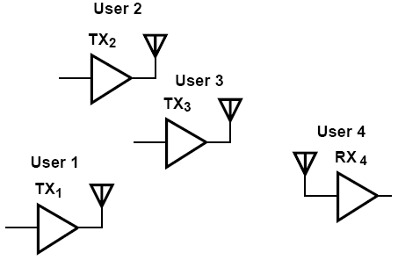
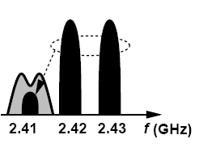
Example of Intermodulation
Suppose four Bluetooth users operate in a room as shown in figure below. User 4 is in the receive mode and attempts to sense a weak signal transmitted by User 1 at 2.410 GHz. At the same time, Users 2 and 3 transmit at 2.420 GHz and 2.430 GHz, respectively. Explain what happens.
Solution:
Since the frequencies transmitted by Users 1, 2, and 3 happen to be equally spaced, the intermodulation in the LNA of R_{X4} corrupts the desired signal at 2.410 GHz.

Slide 16
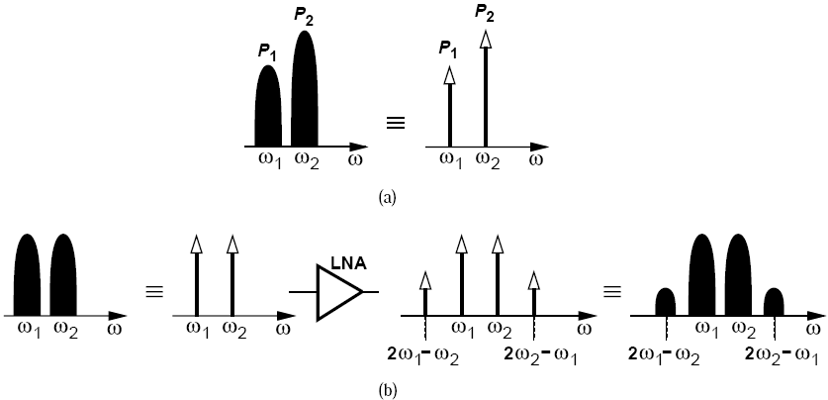
Intermodulation: Tones and Modulated Interferers
In intermodulation Analyses:
(a) approximate the interferers with tones
(b) calculate the level of intermodulation products at the output
(c) mentally convert the intermodulation tones back to modulated components
so as to see the corruption.

Slide 17
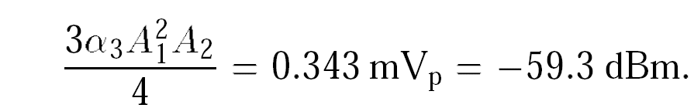
Example of Gain Compression and Intermodulation
A Bluetooth receiver employs a low-noise amplifier having a gain of 10 and an input impedance of 50 Ω. The LNA senses a desired signal level of -80 dBm at 2.410 GHz and two interferers of equal levels at 2.420 GHz and 2.430 GHz. For simplicity, assume the LNA drives a 50-Ω load.
(a) Determine the value of α₃ that yields a P_{1dB} of -30 dBm.
(b) If each interferer is 10 dB below P_{1dB}, determine the corruption experienced by the desired signal at the LNA output.
Solution:
(a) From previous equation, α₃ = 14.500 V-2
(b) Each interferer has a level of -40 dBm (= 6.32 m V_{pp}), we determine the amplitude of the IM product at 2.410 GHz as:

Slide 18
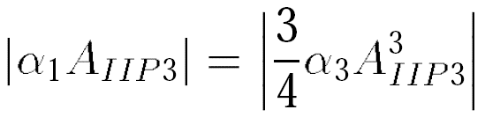
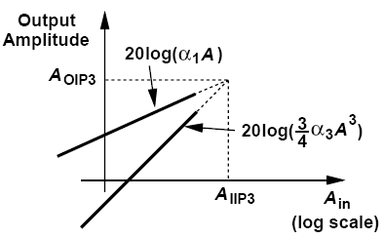
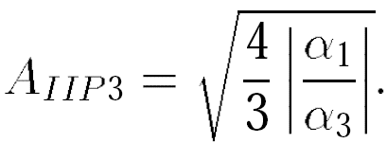
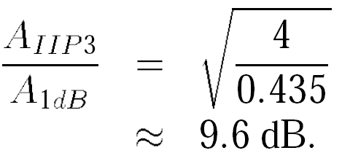
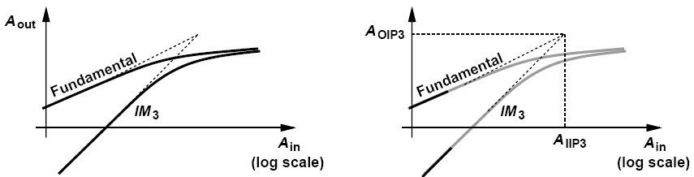
Intermodulation: Third Intercept Point
IP3 is not a directly measureable quantity, but a point obtained by extrapolation

Slide 19
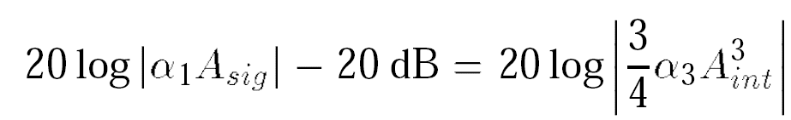
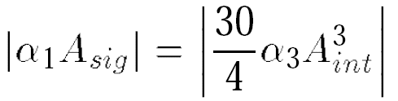
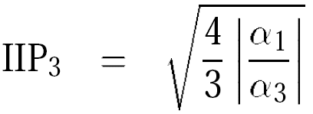
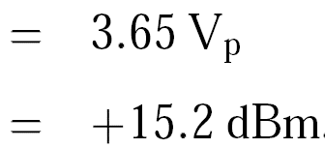
Example of Third Intercept Point
A low-noise amplifier senses a -80-dBm signal at 2.410 GHz and two -20-dBm interferers at 2.420 GHz and 2.430 GHz. What IIP₃ is required if the IM products must remain 20 dB below the signal? For simplicity, assume 50-Ω interfaces at the input and output.
Solution:
At the LNA output:
Thus

Slide 20
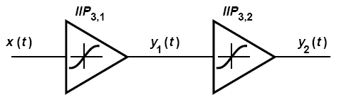
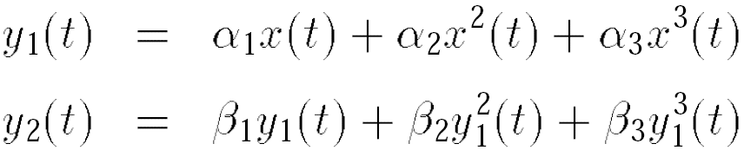
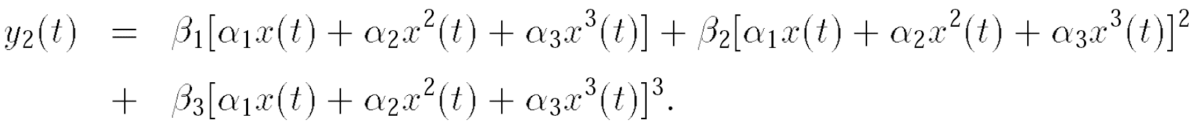
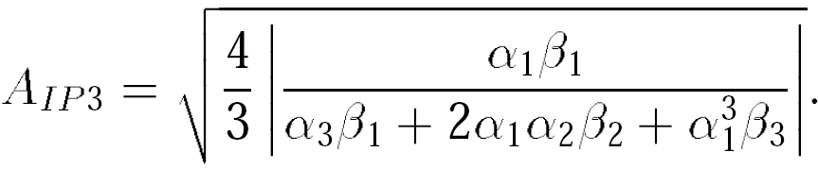
Effects of Nonlinearity: Cascaded Nonlinear Stages
Considering only the first- and third-order terms, we have:
Thus,

Slide 21
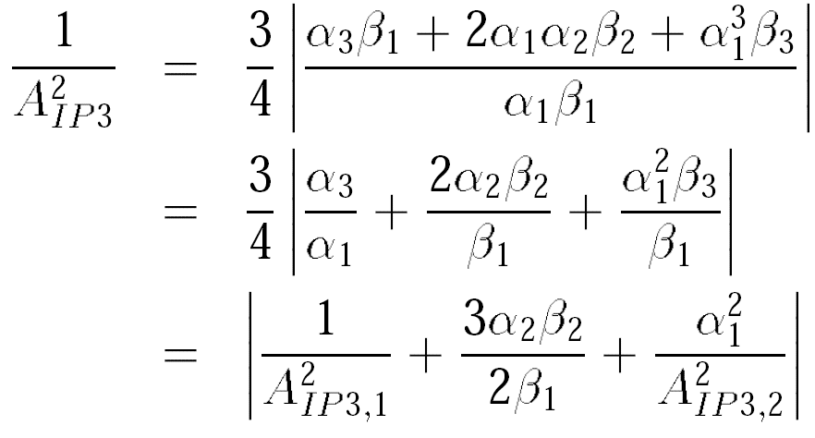
Cascaded Nonlinear Stages: Intuitive results
To “refer” the IP₃ of the second stage to the input of the cascade, we must divide it by α₁. Thus, the higher the gain of the first stage, the more nonlinearity is contributed by the second stage.

Slide 22
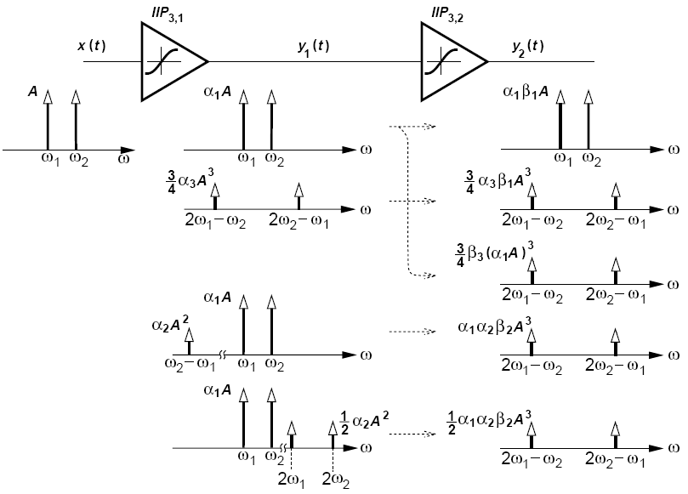
IM Spectra in a Cascade (Ⅰ)
Let us assume _{x(t)} =Acos ω₁t + Acos ω₂t and identify the IM products in a cascade:

Slide 23
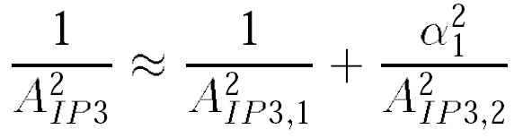
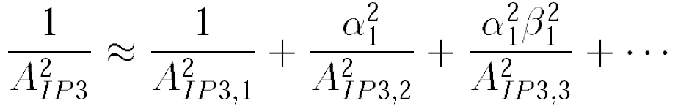
IM Spectra in a Cascade (Ⅱ)
Adding the amplitudes of the IM products, we have
Add in phase as worst-case scenario
Heavily attenuated in narrow-band circuits
For more stages:
Thus, if each stage in a cascade has a gain greater than unity, the nonlinearity of the latter stages becomes increasingly more critical because the IP3 of each stage is equivalently scaled down by the total gain preceding that stage.

Slide 24
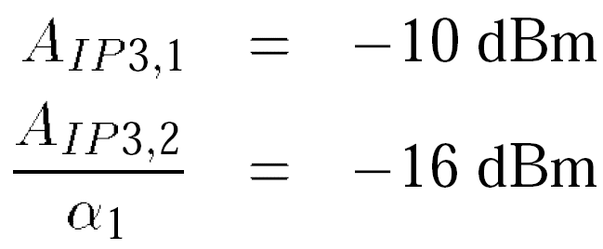
Example of Cascaded Nonlinear Stages
A low-noise amplifier having an input IP₃ of -10 dBm and a gain of 20 dB is followed by a mixer with an input IP₃ of +4 dBm. Which stage limits the IP₃ of the cascade more?
Solution:
With α₁ = 20 dB, we note that
Since the scaled IP₃ of the second stage is lower than the IP₃ of the first stage, we say the second stage limits the overall IP₃ more.

Slide 25
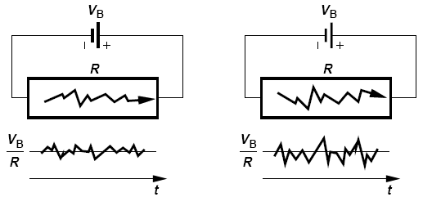
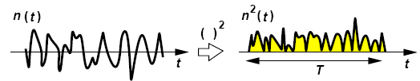
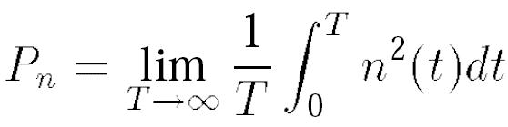
Noise: Noise as a Random Process
Higher temperature
The average current remains equal to V_{B}/R but the instantaneous current displays random values
T must be long enough to accommodate several cycles of the lowest frequency.

Slide 26


Measurement of Noise Spectrum
To measure signal’s frequency content at 10 kHz, we need to filter out the remainder of the spectrum and measure the average power of the 10-kHz component.

Slide 27


Noise Spectrum: Power Spectral Density (PSD)
Two-Sided
One-Sided
Total area under S_{x}(f) represents the average power carried by x(t)

Slide 28



Example of Noise Spectrum
A resistor of value R₁ generates a noise voltage whose one-sided PSD is given by
where k = 1.38 × 10-23 J/K denotes the Boltzmann constant and T the absolute temperature. Such a flat PSD is called “white” because, like white light, it contains all frequencies with equal power levels.
(a) What is the total average power carried by the noise voltage?
(b) What is the dimension of S_{v}(f)?
(c) Calculate the noise voltage for a 50-Ω resistor in 1 Hz at room temperature.
(a) The area under S_{v}(f) appears to be infinite, an implausible result because the resistor noise arises from the finite ambient heat. In reality, S_{v}(f) begins to fall at f > 1 THz, exhibiting a finite total energy, i.e., thermal noise is not quite white.
(b) The dimension of S_{v}(f) is voltage squared per unit bandwidth (V2/Hz)
(c) For a 50-Ω resistor at T = 300 K

Slide 29



Effect of Transfer Function on Noise/ Device Noise
Define PSD to allow many of the frequency-domain operations used with deterministic signals to be applied to random signals as well.
Noise can be modeled by a series voltage source or a parallel current source
Polarity of the sources is unimportant but must be kept same throughout the calculations

Slide 30


Example of Device Noise
Sketch the PSD of the noise voltage measured across the parallel RLC tank depicted in figure below.
Modeling the noise of R₁ by a current source and noting that the transfer function V_{n}/I_{n1} is, in fact, equal to the impedance of the tank, Z_{T} , we write
At f₀, L₁ and C₁ resonate, reducing the circuit to only R₁. Thus, the output noise at f₀
is simply equal to 4kTR₁. At lower or higher frequencies, the impedance of the tank falls and so does the output noise.

Slide 31


Can We Extract Energy from Resistor?
Suppose R₂ is held at T = 0 K (No noise)
This quantity reaches a maximum if R₂ = R₁ :
P_{R2,max} = kT
Available noise power

Slide 32



A Theorem about Lossy Circuit
If the real part of the impedance seen between two terminals of a passive (reciprocal) network is equal to Re{Z_{out}}, then the PSD of the thermal noise seen between these terminals is given by 4kTRe{Z_{out}}
An example of transmitting antenna, with radiation resistance R_{rad}

Slide 33



Noise in MOSFETS
Thermal noise of MOS transistors operating in the saturation region is approximated by a current source tied between the source and drain terminals, or can be modeled by a voltage source in series with gate.

Slide 34




Gate-induced Noise Current
At very high frequencies thermal noise current flowing through the channel couples to the gate capacitively

Slide 35






Flicker Noise and An Example
Can the flicker noise be modeled by a current source?
Yes, a MOSFET having a small-signal voltage source of magnitude V₁ in series with its gate is equivalent to a device with a current source of value g_{m}V₁ tied between drain and source. Thus,
Notes:
K=10^-28 for PMOS, 50 times larger for NMOS
1. Flicker noise is more of a problem in FETs than BJT
2. Worse in NMOS than PMOS
3. Worse for smaller devices
4. 1/f noise adds to the thermal drain current noise

Slide 36




Noise in Bipolar Transistors
Bipolar transistors contain physical resistances in their base, emitter, and collector regions, all of which generate thermal noise. Moreover, they also suffer from “shot noise” associated with the transport of carriers across the base-emitter junction.
In low-noise circuits, the base resistance thermal noise and the collector current shot noise become dominant.

Slide 37

Representation of Noise in Circuits Input-Referred Noise
Voltage source: short the input port of models A and B and equate their output noise voltage
Current source: leave the input ports open and equate the output noise voltage

Slide 38



Example of Input-Referred Noise
Calculate the input-referred noise of the common-gate stage depicted in figure below (left). Assume I₁ is ideal and neglect the noise of R₁.
Solution:
noise voltage
noise current

Slide 39


Noise Figure
Noise Factor
Noise Figure
Depends on not only the noise of the circuit under consideration but the SNR provided by the preceding stage
If the input signal contains no noise, NF=∞
Notes:
Noise Factor = F = total noise power at the output / output noise due to input noise
Noise factor measures how much the system degrades the SNR of the signal
Noise Figure is the Noise factor expressed in dB.

Slide 40







Calculation of Noise Figure
NF must be specified with respect to a source impedance-typically 50 Ω
Reduce the right hand side to a simpler form:

Slide 41
Calculation of NF: Summary
Calculation of NF
Divide total output noise by the gain from V_{in} to V_{out} and normalize the result to the noise of R_{s}
Calculate the output noise due to the amplifier, divide it by the gain, normalize it to 4kTR_{s} and add 1 to the result

Slide 42




Example of Noise Figure Calculation
Compute the noise figure of a shunt resistor R_{P} with respect to a source impedance R_{S}
Solution:
Setting V_{in} to zero:

Slide 43


Another Example of Noise Figure Calculation
Determine the noise figure of the common-source stage shown in below (left) with respect to a source impedance R_{S}. Neglect the capacitances and flicker noise of M₁ and assume I₁ is ideal.
Solution:

Slide 44





Noise Figure of Cascaded Stages
Called “Friis’ equation”, stage increases, implying that the first few stages in a cascade are the most critical. this result suggests that the noise contributed by each stage decreases as the total gain preceding that

Slide 45






Noise Figure of Lossy Circuits
The power loss is calculated as:

Slide 46



Example of Noise Figure of Lossy Circuits
The receiver shown below incorporates a front-end band-pass filter (BPF) to suppress some of the interferers that may desensitize the LNA. If the filter has a loss of L and the LNA a noise figure of NF_{LNA}, calculate the overall noise figure. For example, if L = 1.5 dB and NFLNA = 2 dB
Solution:
Denoting the noise figure of the filter by NF_{filt},
we write Friis’ equation as
where NF_{LNA} is calculated with respect to the output resistance of the filter. For example, if L = 1.5 dB and NF_{LNA} = 2 dB, then NF_{tot} = 3.5 dB.

